Slide 1
6 He also spoke this parable: "A certain man had a fig tree planted in his vineyard, and he came seeking fruit on it and found none.
7 "Then he said to the keeper of his vineyard, ‘Look, for three years I have come seeking fruit on this fig tree and find none. Cut it down; why does it use up the ground?’
SCRIPTURE READING: LUKE 13:6-9

Slide 2
8 "But he answered and said to him, ‘Sir, let it alone this year also, until I dig around it and fertilize it.
9 ‘And if it bears fruit, well. But if not, after that you can cut it down.’"
SCRIPTURE READING: LUKE 13:6-9

Slide 3
2

Slide 4
Lesson 1: A showy religion without substance

Slide 5
PARALLEL SAYINGS
Salt without flavor – Matt. 5:13
A lamp hidden – Matt. 5:14 – 16
Clouds without rain – Jude 1:12
Drinking rain and bearing briars –Heb. 6:7, 8

Slide 6
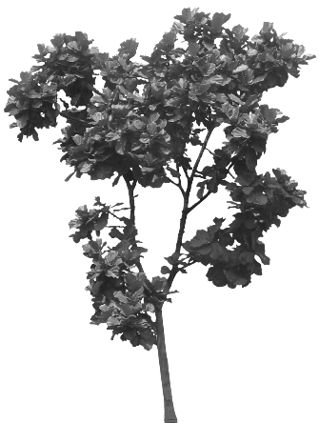
Parable of the Fig Tree LUKE 13:6-9
Preface With a Flawed View of Suffering
Luke 13:1-5

Slide 7
“WERE ONCE” (BC)
Foolish → Hateful
“TO BE” (AC)
Obey → All Humility
Titus 3:1-3

Slide 8
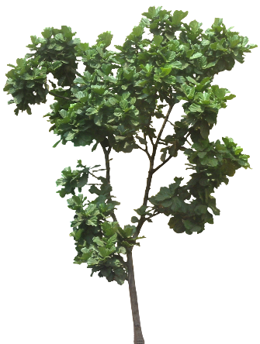
Luke 13:6-9
GOD & FRUITLESSNESS
God expects fruit
God is merciful to extend time
God takes away any excuse
God’s mercy eventually ends

Slide 9
“…I never knew you; depart from Me, you who practice lawlessness!”
Matthew 7:23
An Illegal Religion
Mark 11:15-19

Slide 10
FLASHBACK!
Three Years Earlier: John 2:12-16
“Take these things away! Do not make My Father’s house a house of merchandise!’”

Slide 11
Today:
Take away the money-making schemes!
Fruit-bearing Christians will give liberally and joyfully on the Lord’s Day (Rom. 12:8; 2 Cor. 9:7)
“Abide in Me, and I in you. As the branch cannot bear fruit of itself, unless it abides in the vine, neither can you, unless you abide in Me.”
John 15:4

Slide 12
Today:
Take away the money-making schemes!
Take away the wares!
Fruit-bearing Christians yearn for the spiritual food of Christ (Jn. 6:27, 63, 68; 1 Cor. 11:22)
“Abide in Me, and I in you. As the branch cannot bear fruit of itself, unless it abides in the vine, neither can you, unless you abide in Me.”
John 15:4

Slide 13
Today:
Take away the money-making schemes!
Take away the wares!
Take away the band!
Fruit-bearing Christians worship in spirit and truth (Amos 5:23; Col. 3:16, 17; Eph. 5:19)
“Abide in Me, and I in you. As the branch cannot bear fruit of itself, unless it abides in the vine, neither can you, unless you abide in Me.”
John 15:4

Slide 14
Today:
Take away the money-making schemes!
Take away the wares!
Take away the band!
Take away the Sabbath and tithing!
“Abide in Me, and I in you. As the branch cannot bear fruit of itself, unless it abides in the vine, neither can you, unless you abide in Me.”
John 15:4

Slide 15
Despite the passing of three years, they bore no fruit of repentance (Mk. 11:18)

Slide 16
The barren fig tree: “Let no one eat fruit from you ever again” (Mk. 11:14)
The lawless temple-worship: “Not one stone shall be left upon another that shall not be thrown down” (Mk. 13:2)

Slide 17
37 "O Jerusalem, Jerusalem, the one who kills the prophets and stones those who are sent to her! How often I wanted to gather your children together, as a hen gathers her chicks under her wings, but you were not willing!
38 "See! Your house is left to you desolate;
Matthew 23:37, 38

