Slide 1
2 SAMUEL 11:8-15

Slide 2
Coveted – 2 Sam. 11:1, 2
Committed – 2 Sam. 11:3-5
Covered – 2 Sam. 11:6-15
Ahithophel
Eliam
Bathsheba

Slide 3
Proverbs 6:32, 33
32 Whoever commits adultery with a woman lacks understanding; He who does so destroys his own soul.
33 Wounds and dishonor he will get, And his reproach will not be wiped away.
wounds
lacks understanding
reproach
dishonor
destroys soul

Slide 4
Self-indulgence Versus Self-control
“And David said to Uriah, ‘Go down to your house and wash your feet.’ So Uriah departed from the king’s house, and a gift of food from the king followed him.” 2 Sam. 11:8
2 Samuel 11:9-11
Veiled Conscience

Slide 5
Psalm 55:20, 21
“He has put forth his hands against those who were at peace with him; He has broken his covenant. The words of his mouth were smoother than butter, But war was in his heart; His words were softer than oil, Yet they were drawn swords.”
Psalm 12:2
This Photo by Unknown Author is licensed under CC BY-SA

Slide 6
DRINK!
“Now when David called him, he ate and drank before him; and he made him drunk. And at evening he went out to lie on his bed with the servants of his lord, but he did not go down to his house.”
2 Samuel 11:13
Habakkuk 2:15, “Woe to him who gives drink to his neighbor, Pressing him to your bottle, Even to make him drunk, That you may look on his nakedness!”
Veiled Conscience

Slide 7
DRINK!
“Now when David called him, he ate and drank before him; and he made him drunk. And at evening he went out to lie on his bed with the servants of his lord, but he did not go down to his house.”
2 Samuel 11:13
Habakkuk 2:15, “Woe to him who gives drink to his neighbor, Pressing him to your bottle, Even to make him drunk, That you may look on his nakedness!”
Veiled Conscience

Slide 8
DRINK THE POIS N?
Proverbs 23
31 Do not look on the wine when it is red, When it sparkles in the cup, When it swirls around smoothly;
At the last it bites like a serpent, And stings like a viper.
Your eyes will see strange things, And your heart will utter perverse things.
Veiled Conscience
This Photo , edited, is licensed under CC BY-SA
This Photo by Unknown Author is licensed under CC BY-SA
This Photo by Unknown Author is licensed under CC BY

Slide 9
A Messenger of Death
14 In the morning it happened that David wrote a letter to Joab and sent it by the hand of Uriah.
15 And he wrote in the letter, saying, “Set Uriah in the forefront of the hottest battle, and retreat from him, that he may be struck down and die.”
(2 Sam. 11:14, 15)
Veiled Conscience

Slide 10
“My soul is among lions; I lie among the sons of men Who are set on fire, Whose teeth are spears and arrows, And their tongue a sharp sword.”
Psalm 57:4

Slide 11
DAVID (Beloved)
A Judean
A mighty warrior
Exercised self-restraint
Thoughtful of the ark
Thoughtful of Israel and Judah
Thoughtful of his fellow soldiers and commanding officer
A faithful messenger

Slide 12
URIAH (Jehovah is my light)
A Gentile
A mighty warrior
Exercised self-restraint
Thoughtful of the ark
Thoughtful of Israel and Judah
Thoughtful of his fellow soldiers and commanding officer
A faithful messenger

Slide 13
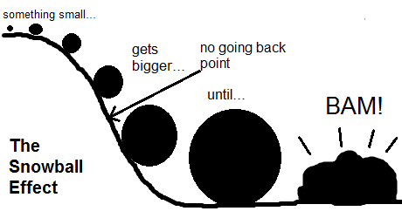
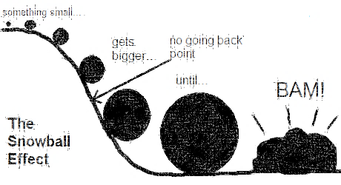
DAVID’S Snowball of Sin
“Sin will take you farther than you ever expected to go; it will keep you longer than you ever intended to stay, and it will cost you more than you ever expected to pay.”
Idleness
Looking
Coveting
Despising Commandment
Stealing
Adultery
Drinking
Deception
Premeditation of Murder
Murder
This Photo (edited) is licensed under CC BY-SA
Veiled Conscience

Slide 14
2 Samuel 11:26, 27
26 When the wife of Uriah heard that Uriah her husband was dead, she mourned for her husband.
27 And when her mourning was over, David sent and brought her to his house, and she became his wife and bore him a son. But the thing that David had done displeased the LORD.
What all sin does!

Slide 15
Lacking Conscience & Reflection?
The tremendous benefit of feeling guilt:
Required for the Holy Spirit to “convict”
John 16:8
Enables one to hear
Exod. 7:13
Enables one to see his error
2 Samuel 24:10
Enables one to repent and be forgiven
2 Cor. 7:10; Acts 2:37, 38; 1 John 1:9

Slide 16
Self-condemnation After Reconciliation?
The tremendous danger of feeling false guilt:
The feeling of condemnation and failure after receiving forgiveness

Slide 17
“But evil men and impostors will grow worse and worse, deceiving and being deceived” (2 Tim. 3:13)
“But if you do not do so, then take note, you have sinned against the LORD; and be sure your sin will find you out” (Num. 32:23)

