Slide 1
Part 5

Slide 2
Why Did Eve Fall?
“So when the woman saw that the tree was good for food, that it was pleasant to the eyes, and a tree desirable to make one wise, she took of its fruit and ate. She also gave to her husband with her, and he ate.”
GENESIS 3:6

Slide 3
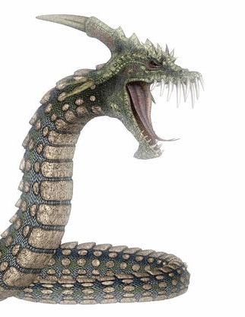
Why Did Eve Fall?
Lied to?
Forced to?
Her downfall stemmed from something within her:
2 Thess. 2:9, 10; James 1:14, 15
When we are drawn away by our own desires, we are not concerned with _____ will
Misplaced love, doubts, & desires
GOD’S

Slide 4
Eve’s Enticement
The lust of the flesh — good for food
The lust of the eyes — pleasant to the eyes
The pride of life —desirable to make wise
“For all that is in the world—the lust of the flesh, the lust of the eyes, and the pride of life—is not of the Father but is of the world” (1 Jn. 2:16).

Slide 5
Eve’s Enticement
The lust of the flesh — good for food
The lust of the eyes — pleasant to the eyes
The pride of life —desirable to make wise
Example—Israel, Numbers 11:4-35; Psalm 78:18
Warning — Ephesians 2:1-3; 1 Peter 4:2; Galatians 5:17ff
Remedy — Romans 13:14

Slide 6
Eve’s Enticement
The lust of the flesh — good for food
The lust of the eyes — pleasant to the eyes
The pride of life —desirable to make wise
Example—Achan, Joshua 7:21 | David, 2 Samuel 11:2-4
Warning—Matthew 5:28
Remedy—Matthew 5:28; Job 31:1; Prov. 23:31; Genesis 19:17; 2 Cor. 4:18; Hebrews 11:25-27

Slide 7
Eve’s Enticement
The lust of the flesh — good for food
The lust of the eyes — pleasant to the eyes
The pride of life —desirable to make wise
Example—apostles, Luke 22:24; Haman, Esther 3:5
Warning—Proverbs 3:7; 26:12; 16:18; John 5:44
Remedy—1 Corinthians 8:2; Romans 12:16

Slide 8
The Lord’s Victory
Tempted in all points as we are
Hebrews 4:15
Assailed while physically weak
Matthew 4:1-11
Centered on “the will of the Father” and “what is written”

Slide 9
Conclusion:
Satan is real
If not, who tempted Eve, Jesus, etc.?
Satan is our adversary
1 Peter 5:8
Satan is the tempter
Matthew 4:3; 1 Thessalonians 3:5
Satan can be resisted
James 4:7, 8

