Slide 1
Noah’s
GENESIS 8

Slide 2
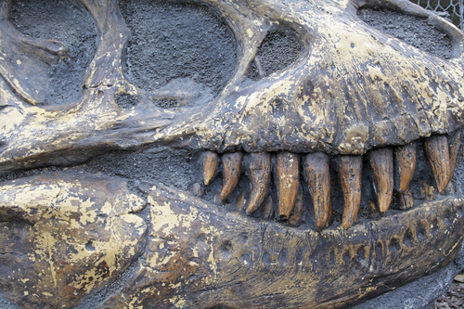
⇜Our Views ⇝
1. God’s Unchanging Word
2. Man’s Wisdom
CREATION: God created the heavens, earth, and all things (Gen. 1, 2)
MASSIVE DIE-OFF: global flood (Gen. 6-9)
CREATION: Big bang out of nothing; evolution of life from non-living material
MASSIVE DIE-OFF: extraterrestrial impact, volcanism, toxic water
3. Mixed & Mashed

Slide 3
GENESIS 7:23, 24
23 So He destroyed all living things which were on the face of the ground: both man and cattle, creeping thing and bird of the air. They were destroyed from the earth. Only Noah and those who were with him in the ark remained alive.
24 And the waters prevailed on the earth one hundred and fifty days.

Slide 4
GOD REMEMBERED
GENESIS 8:1-5

Slide 5
WRATH & MERCY
GENESIS 7
GENESIS 8
WRATH
GRACE

Slide 6
God Does Not Forget His People
ISRAELITES IN EGYPT
Ex. 2:23-25; 9:1-7, 22-26; 11:7

Slide 7
Isaiah 49:14-16
¹⁴ But Zion said, "The LORD has forsaken me, And my Lord has forgotten me."
¹⁵ "Can a woman forget her nursing child, And not have compassion on the son of her womb? Surely they may forget, Yet I will not forget you.
¹⁶ See, I have inscribed you on the palms of My hands; Your walls are continually before Me.

Slide 8
WHEN GOD REMEMBERED NOAH
Made a wind
Stopped fountains of deep
Closed windows of heaven
Lowered the valleys and pushed up the mountains

Slide 9
Noah Waited
GENESIS 8:6-19

Slide 10
THE PATIENT WAITING
Ark Rests
Mount. Tops
Opens Window
Waits 7 Days
Waits 7 Days
7th mo., 17th d.
10th mo., 1st d.
11th mo., 10th d.
11th mo., 17th d.
11th mo., 24th d.
Removes Cover
1st mo., 1st d.
Exits Ark
2nd mo., 27th d.
Gen. 8:4
Gen. 8:5
Gen. 8:6
Gen. 8:10
Gen. 8:12
Gen. 8:13
Gen. 8:14-16
3 mo., 23 days
5 ½ mo.
7 mo., 10 days

