Slide 1
Satan’s
If I Were
MINISTER
(part 6)

Slide 2
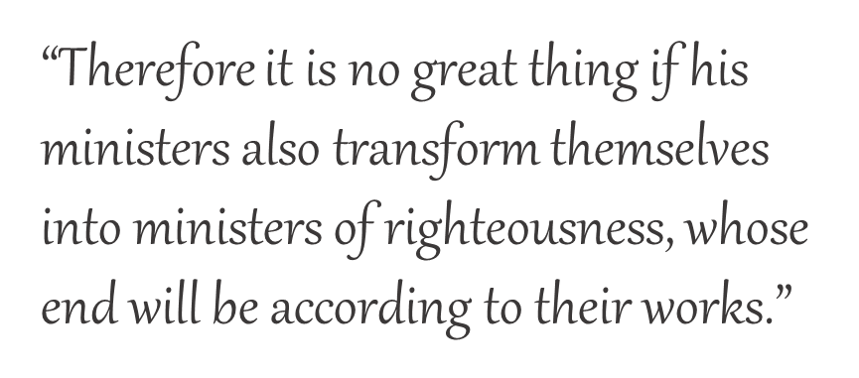
Previously:
If I Were Satan’s Minister, I would:
Teach that someone like me does not exist
Promote the one-man-pastor system
Emphasize sincerity over truth
Embrace all forms of worship
Embrace Calvinism
2 Corinthians 11:15

Slide 3
Essentials of Calvinism:
2 Corinthians 11:15
“Wholly of grace”
“Salvation is all of God and none of me”
“Faith is a gift of God”
“Salvation is by faith alone”
Etc.

Slide 4
If I were Satan’s Minister…
“Faith and repentance are two sides of the same coin.”
I would teach that faith and repentance occur at the same time—a change of mind.

Slide 5
REPENTANCE
The teaching of men versus the teaching of God
Is “repentance” simply a change of mind?

Slide 6
Jesus & Jonah
Matthew 12:41
Jonah 3:10
Nineveh repented at the preaching of Jonah
God saw their works, that they turned from their evil way
Jesus defined repentance as the “work” of turning from evil!

Slide 7
Man’s Ways Lead To The Exclusion of REPENTANCE
3 Reasons Why I Don’t Preach On Repentance (“Turn from Sin”)
Paul Ellis
“Religious people often complain that we grace preachers don’t emphasize repentance sufficiently. It’s true. I hardly emphasize it at all. But then neither did the Apostle John.”

Slide 8
Man’s Ways Lead To The Exclusion of REPENTANCE
3 Reasons Why I Don’t Preach On Repentance (“Turn from Sin”)
Paul Ellis
“Here’s something that will fry your mind: Repentance is one of the most important things you’ll ever do but John never mentions it. Not once. Not in his gospel or in any of his three letters. I guess John must’ve been a grace preacher.”

Slide 9
“The entirety of Your word is truth, And every one of Your righteous judgments endures forever” (Psa. 119:160)

Slide 10
How Important Was REPENTANCE to the Apostle John?

Slide 11
In Revelation
Where sin existed in the seven churches
For the rest of mankind
Ephesus, 2:5
Pergamos, 2:16
Thyatira, 2:21, 22
Sardis, 3:3
Laodicea, 3:19
Revelation 9:20, 21
Revelation 16:9, 11
REPENT!
TEN TIMES in REVELATION!
REPENT!

Slide 12
In What He Saw Required of Others
The diseased man
John 5:1-14
The woman caught in adultery
John 8:1-11

Slide 13
In What He Saw Required of Others
The people (Jn. 12:20-43)
“see” + “understand” + “turn” → “heal” (v. 40)
Turning around—Jn. 21:20
Turning to the Lord—Acts 3:19; 9:35; etc.
Turning from sin—Acts 26:18; Jas. 5:19, 20

Slide 14
In What Was Required Of Him
A son of thunder (Mk. 3:17)
“probably…stormy and destructive temper” (J. W. McGarvey)
Was zealous to destroy adversaries (Lk. 9:51-58)
Sought preeminence over the other apostles (Mk. 10:35-45)

Slide 15
Transformed
Followed Jesus to His death
Was entrusted with the care of Mary (Jn. 19:25-27)
Lost his brother to Herod’s violence (Acts 12:1, 2)
Thundered against sin (1 Jn. 2:4, 22; 3:15; etc.)
Encouraged the understanding of forgiveness through our Advocate (1 Jn. 2:1, 2, 12)
Emphasized the love of our Father and the relationship of being a child of God (1 Jn. 3:1)

Slide 16
Transformed
Love of God’s children (1 Jn. 3:16-18; 4:7ff)
Why we love God (1 Jn. 4:19)
How we love God (1 Jn. 5:3)
Where our life is (1 Jn. 5:11, 12)
The snare to life (2 Jn. 9-11)
Calling down the pursuit for preeminence (3 Jn. 9-11)

