Slide 1
FRUIT OF THE SPIRIT
“JOY” &
“PEACE”

Slide 2
Galatians 5:22, 23
But the fruit of the Spirit is love, joy, peace, longsuffering, kindness, goodness, faithfulness, gentleness, self-control. Against such there is no law.

Slide 3
“Knowing Jesus”
WILL NOT TAKE PAINFUL, SAD, AND ADVERSE EXPERIENCES AWAY FROM LIFE
  “Yes, and all who desire to live godly in Christ Jesus will suffer persecution” (2 Tim. 3:12)
  Acts 20:18, 19, “You know, from the first day that I came to Asia, in what manner I always lived among you, serving the Lord with all humility, with many tears and trials which happened to me by the plotting of the Jews.”
  2 Corinthians 11:23-28

Slide 4
“Knowing Jesus”
WILL NOT TAKE PAINFUL, SAD, ADVERSE AND EXPERIENCES AWAY FROM LIFE
WILL IMPART A MEASURE OF JOY AND PEACE WITHIN ADVERSITY

Slide 5
Defining Joy & Peace
“JOY”
  great happiness – feelings of great happiness or pleasure, especially of an elevated or spiritual kind
  something that brings happiness – a pleasurable aspect of something, or something that is seen as a source of happiness
  (Encarta Dictionary)

Slide 6
Defining Joy & Peace
“PEACE”
  freedom from war – freedom from war, or the time when a war or conflict ends
  mental calm – a state of mental calm and serenity, with no anxiety
  (Encarta Dictionary)

Slide 7
The Christian’s
“Peaceful Trichotomy”
Peace with God
  Romans 5:1, “Therefore, having been justified by faith, we have peace with God through our Lord Jesus Christ”
Peace with fellowman
  Rom. 12:18, “If it is possible, as much as depends on you, live peaceably with all men”
Peace with self (Phil. 4:6-9)

Slide 8
The World’s Wrong Reach
The world seeks joy:
  by dismissing or eliminating sorrow
  by filling life with “pleasurable things”
PROBLEM:
  sorrow surrounds everyone and easily infuses the mind
  no lasting effect from material/physical “things” (Eccl. 2:1-11, 17, 18; 1 Jn. 2:17)

Slide 9
JOY IN ADVERSITY?
10 Blessed are those who are persecuted for righteousness’ sake, For theirs is the kingdom of heaven.
11 "Blessed are you when they revile and persecute you, and say all kinds of evil against you falsely for My sake.
12 "Rejoice and be exceedingly glad, for great is your reward in heaven, for so they persecuted the prophets who were before you.
MATTHEW 5:10-12

Slide 10

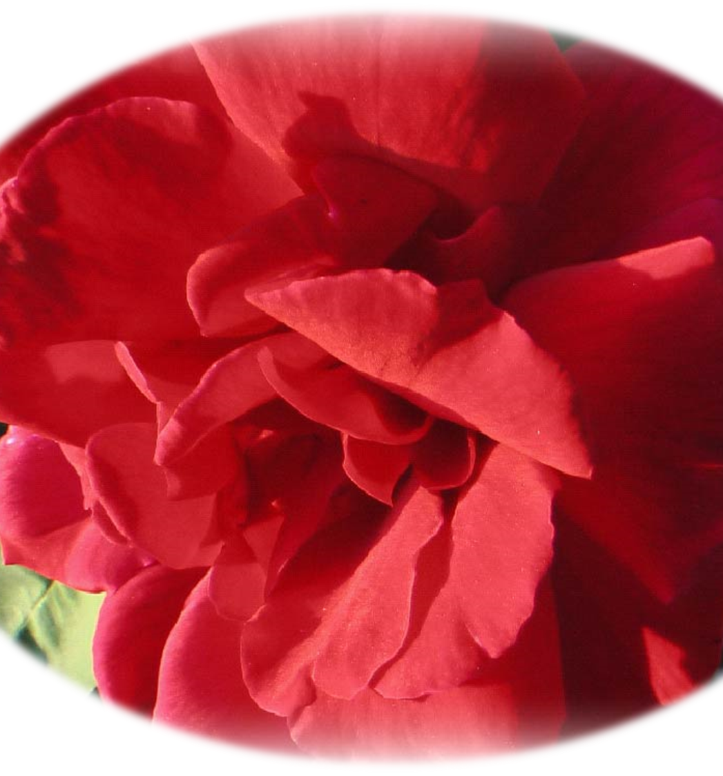
The Rose
“How can any beautiful flower come from a plant burdened with so many sharp thorns?”

Slide 11
JOY BLOOMS IN ADVERSITY?
9 For I think that God has displayed us, the apostles, last, as men condemned to death; for we have been made a spectacle to the world, both to angels and to men.
10 We are fools for Christ’s sake, but you are wise in Christ! We are weak, but you are strong! You are distinguished, but we are dishonored!
11 To the present hour we both hunger and thirst, and we are poorly clothed, and beaten, and homeless.
12 And we labor, working with our own hands. Being reviled, we bless; being persecuted, we endure;
13 being defamed, we entreat. We have been made as the filth of the world, the offscouring of all things until now.
1 CORINTHIANS 4:9-13

Slide 12
Persecution Blossoms Into Joy & Peace
Acts 5:41 “So they departed from the presence of the council, rejoicing that they were counted worthy to suffer shame for His name”
Philippians 2:17 “Yes, and if I am being poured out as a drink offering on the sacrifice and service of your faith, I am glad and rejoice with you all”

Slide 13
WHY?
“JOY” & “PEACE” ARE NOT CONNECTED WITH EXTERNAL CIRCUMSTANCES
“JOY” & “PEACE” ARE CONNECTED TO CHRIST’S VINE
“² My brethren, count it all joy when you fall into various trials, ³ knowing that the testing of your faith produces patience” (Jas. 1:2, 3)

Slide 14
For What Should We Be Joyful?
1. That our Savior has come:
  ¹⁰ Then the angel said to them, "Do not be afraid, for behold, I bring you good tidings of great joy which will be to all people.
  ¹¹ "For there is born to you this day in the city of David a Savior, who is Christ the Lord.
  (Lk. 2:10, 11)

Slide 15
For What Should We Be Joyful?
2. That we have found the kingdom of heaven:
  Matthew 13:44,
  “Again, the kingdom of heaven is like treasure hidden in a field, which a man found and hid; and for joy over it he goes and sells all that he has and buys that field.”

Slide 16
For What Should We Be Joyful?
3. That our names are written in heaven:
  Luke 10:20
  “Nevertheless do not rejoice in this, that the spirits are subject to you, but rather rejoice because your names are written in heaven.”

Slide 17
For What Should We Be Joyful?
4. That we have fellowship with one another:
  ¹⁵ Rejoice with those who rejoice, and weep with those who weep.
  ¹⁶ Be of the same mind toward one another. Do not set your mind on high things, but associate with the humble. Do not be wise in your own opinion.
  Romans 12:15, 16

Slide 18
For What Should We Be Joyful?
5. That some who were lost repented
  Luke 15:7,
  “I say to you that likewise there will be more joy in heaven over one sinner who repents than over ninety-nine just persons who need no repentance.”

Slide 19
Fruit of the Spirit
CONNECTED TO THE VINE (Jn. 15:4-8)
  Must abide in (v. 4)
  Cannot do anything without the vine (v. 5)
  Wither when apart from Christ (v. 6)
    Cast into the fire
  The privilege to “ask” when we abide in (v. 7)
  Bear much fruit…glorify the Father…My disciples (v. 8)

Slide 20
Revelation 19:5-7
5 Then a voice came from the throne, saying, "Praise our God, all you His servants and those who fear Him, both small and great!"
6 And I heard, as it were, the voice of a great multitude, as the sound of many waters and as the sound of mighty thunderings, saying, "Alleluia! For the Lord God Omnipotent reigns!
7 "Let us be glad and rejoice and give Him glory, for the marriage of the Lamb has come, and His wife has made herself ready."

Slide 21
JOHN 8:32
Jesus on Discipleship!
“Then Jesus said to those Jews who believed Him, ‘If you abide in My word, you are My disciples indeed.’”
“He who believes and is baptized will be saved; but he who does not believe will be condemned.”
MARK 16:16
Jesus on Salvation!

